Slide 1
Capstone Project – 2
Supervised Machine Learning
-Regression
Yes Bank Stock Closing Price Prediction
Prepared by Team AMOL:-
Amol Kale
Mukund Pandit
Ayushi Jain
Sidharth Budhiraja

Slide 2

Will Be Discussing On:
Problem Statement
Introduction
Data Cleaning
Exploratory Data Analysis (EDA)
Transforming Data
Splitting Data
Fitting Different Model
Cross Validation & Hyperparameter Tuning
Conclusion

Slide 3

1. Problem Statement:
Prediction of Yes Bank stock closing price.
Getting accuracy score of several machine learning
model.
Will be discovering important factors that govern hotel year to book a hotel room.
bookings. The best time of

Slide 4
2. Introduction:
Date: Monthly observation of stock prices since its inception.
Open: The price of a stock when stock exchange market open for the day.
Close: The price of a stock when stock exchange market closed for the day.
High: The maximum price of a stock attained during given period of time.
Low: The minimum price of a stock attained during given period of time.

Slide 5

3. Data Cleaning
Null Values Treatment
Duplicated Values Treatment
Date Format Change
(i.e from Jul-05 to 2005-07-01)

Slide 6
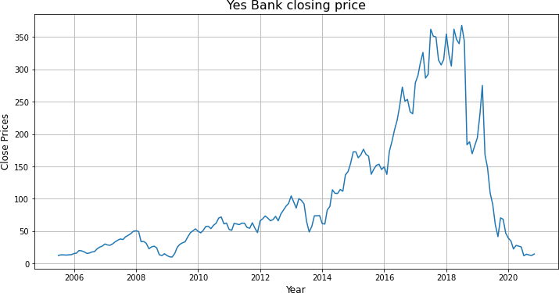
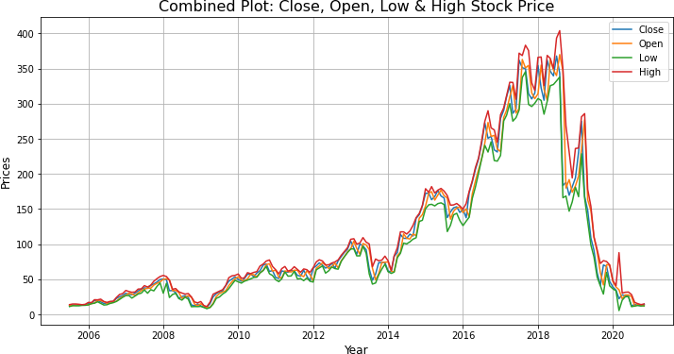
4. Exploratory Data Analysis (EDA)
Sudden fall in stock after 2018 which justify the effect of fraud case involving Rana Kapoor.
From combined plot, it shows strong correlation between each feature.

Slide 7
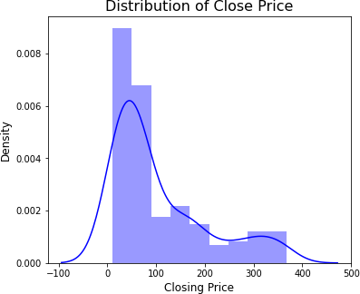
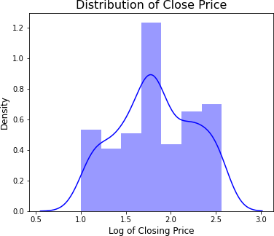
EDA (Continued)
Distribution of Closing Price:
After Log Transformation
• Distribution of closing price is right skewed.
• We need this distribution to be normal distribution for training algorithm.
• Distribution of closing price is normal distribution.

Slide 8
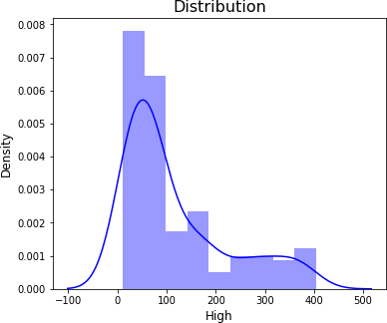
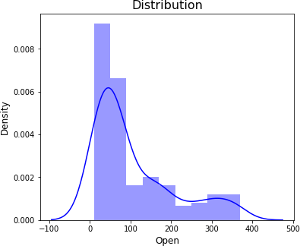
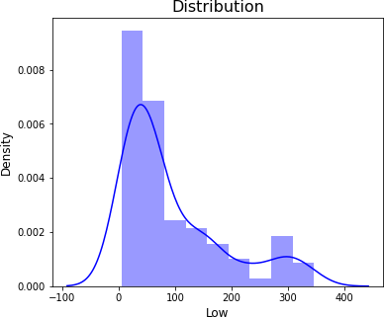
EDA (Continued)
Distribution of Open, High & Low Price of a stock:
• Distribution of opening price, high price and low price are also right skewed.
• Log transformation applied to make this distribution normal.

Slide 9
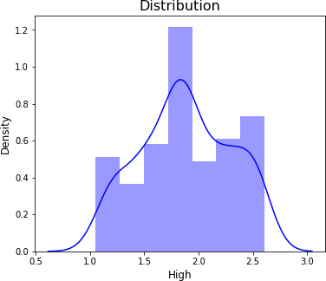
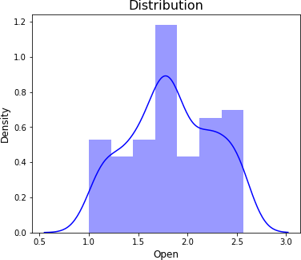
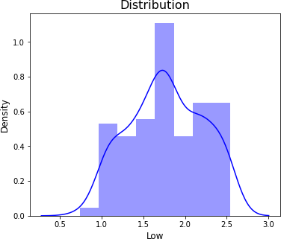
EDA (Continued)
Distribution of Open, High & Low Price of a stock after Log Transformation:
• Distribution of opening price, high price and low price are now normal distribution.

Slide 10
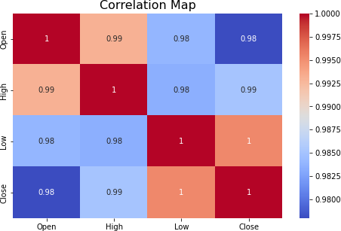
EDA (Continued)
Correlation:
• All the features are strongly correlated with each other.

Slide 11

5. Transformation of Data
To scale data into a uniform format that would allow us to utilize the data in a better way.
For performing fitting and applying different algorithms to it.
The basic goal was to enforce a level of consistency or uniformity to dataset.

Slide 12
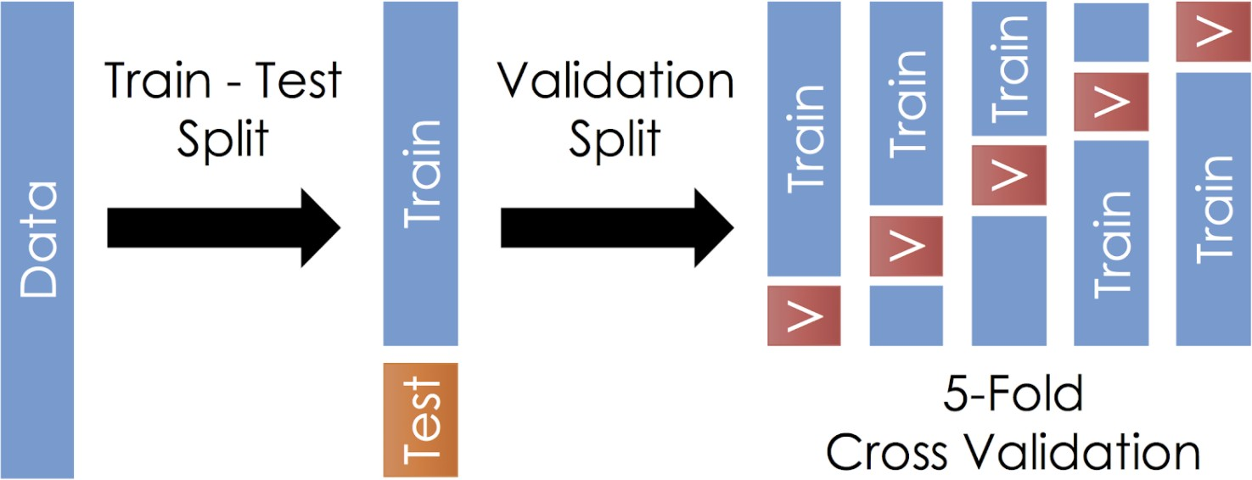
6. Splitting Data
Data splits into training dataset and testing dataset.
Training dataset is for making algorithm learn and train model.
Test dataset is for testing the performance of train model.
Here 80% of data taken as training dataset & remaining 20% of dataset used for testing purpose.

Slide 13
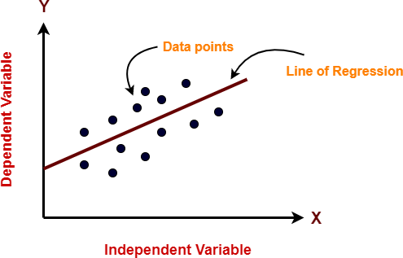
7. Fitting Different Model
7.1 Linear Regression
Linear regression is one of the easiest and most popular Machine Learning algorithms.
It is a statistical method that is used for predictive analysis.
Linear regression algorithm shows a linear relationship between a dependent and independent variable; hence it is called as linear regression.
Evaluation Metrics: Linear Regression
MSE | RMSE | MAE | MAPE | R2
0.032 | 0.178 | 0.151 | 0.095 | 0.823

Slide 14
7.2 Lasso Regression
Lasso: Least Absolute Shrinkage and Selection operator
It is a regression analysis method that performs both variable selection and regularization in order to enhance the prediction accuracy and interpretability of the resulting statistical model.
This method performs L1 regularization.
Evaluation Metrics: Lasso Regression
MSE | RMSE | MAE | MAPE | R2
0.032 | 0.179 | 0.152 | 0.096 | 0.820

Slide 15
7.3 Ridge Regression
Ridge regression is a model tuning method that is used to analyses any data that suffers from
multicollinearity.
When the issue of multicollinearity occurs, least-squares are unbiased, and variances are large, this results in predicted values to be far away from the actual values.
This method performs L2 regularization.
Evaluation Metrics: Ridge Regression
MSE | RMSE | MAE | MAPE | R2
0.032 | 0.178 | 0.151 | 0.095 | 0.823

Slide 16
7.2 Elastic Net
Elastic net is a popular type of regularized linear regression that combines two popular penalties,
specifically the L1 and L2 penalty functions.
Elastic Net is an extension of linear regression that adds regularization penalties to the loss function during training.
Evaluation Metrics: Elastic Net
MSE | RMSE | MAE | MAPE | R2
0.036 | 0.191 | 0.157 | 0.102 | 0.820

Slide 17
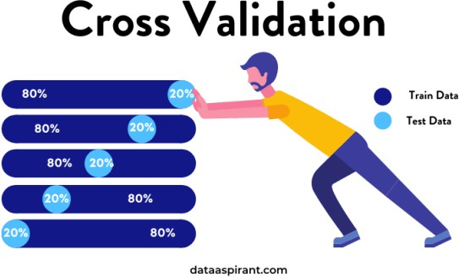
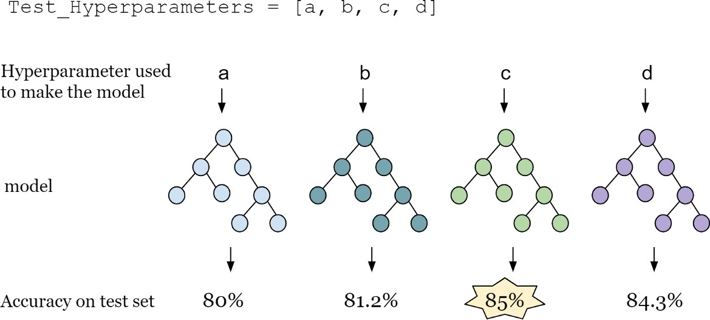
8. Cross Validation & Hyperparameter Tuning
It is a resampling procedure used to evaluate machine learning models on a limited data sample.
Basically, Cross Validation is a technique using which Model is evaluated on the dataset on which it is not trained that is it can be a test data or can be another set as per availability or feasibility.
Tuning the hyperparameters of respective algorithms is necessary for getting better accuracy and to avoid
overfitting.

Slide 18
Evaluation Metrics: CV & tuning on Lasso Regression
MSE | RMSE | MAE | MAPE | R2
0.032 | 0.180 | 0.153 | 0.097 | 0.819
Cross Validation & Hyperparameter tuning
on Lasso Regression
Evaluation Metrics: CV & tuning on Ridge Regression
MSE | RMSE | MAE | MAPE | R2
0.033 | 0.180 | 0.153 | 0.097 | 0.817
Cross Validation & Hyperparameter tuning on Ridge Regression
Evaluation Metrics: CV & tuning on Elastic Net
MSE | RMSE | MAE | MAPE | R2
0.032 | 0.180 | 0.153 | 0.097 | 0.819
Cross Validation & Hyperparameter tuning on Elastic Net

Slide 19
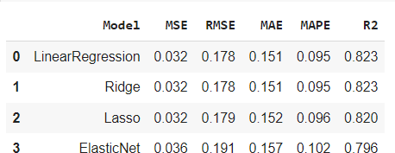
9. Evaluation Metrics Comparison

Slide 20
10. Conclusion
1. We got a maximum accuracy score of 82%.
2. Linear, lasso and ridge regression show almost same R squared values.
3. Whereas elastic net model shows lowest R squared value and high MSE, RMSE, MAE & MAPE values.
4. Close, Open and high price of stock are strongly correlated with each other.

